Slide 1
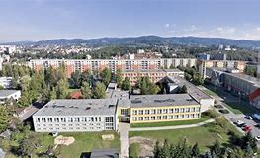
My school

Slide 2
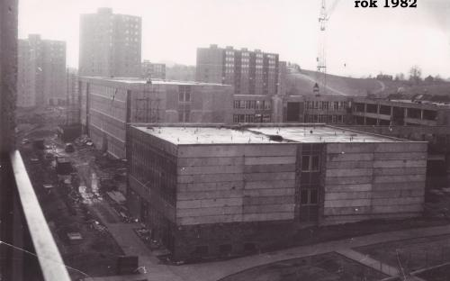
Our school
Our school is 35 years old.
First director was Vladimír Cvrček.
In our school are 22 classes.
Our school has got 2 gyms.
We have got new computer class.

Slide 3
MY school plan
 | 1 | 2 | 3 | 4 | 5 | 6
Monday | CZ | Mat | Bio | Pe | E
Tuesday | E | CZ | Mat | Desing | CZ
Wednesday | CZ | Mat | Mu | His | E | Pe
Thursday | CZ | Mat | CZ | Art | Art
Friday | CZ | His | E | ICT | Mat

Slide 4
Me and my school
My favorite subject is ICT.
My favorite is Friday.
I don´t like Music.
I like go to the trip and to the school in nature.
My favorite teachers are R. Jančo and I. Kolátorová.

Slide 5
My class
In my class is 23 students.
In our class is 7 boys and 16 girls.
Our class is friendly.
We have got new class teacher her name is Tereza Lupínková.
In our class teach five teachers.
I like all teachers.
We like go to school in nature.

Slide 6
Mgr. Tereza Lupínková
It is our class teacher.
She is 26 years old.
She has got 1 sister and 1 brother.
Her favorite colors are green and yellow.
She teaches in our class Czech, Maths, Art and Design, Biology and Music.
She likes numbers 1 2 3.
She likes old films.
She has got budgie.

Slide 7
Mgr. Zuzana Jedličková
She teaches in our class English.
She likes traveling.
Her favorite hobby is cycling.
Her favorite food is Stifado. It is greek food with onion.
She hasn´t got a pet.
She is sometimes strict but she is fair teacher.
She is willing teacher.

Slide 8
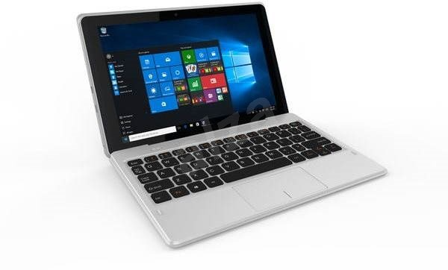
Robert Jančo
He teaches in our class ICT.
He likes chess game and he teaches chess in the school.

