Slide 1
Patrik Štajnc
Class 5.A

Slide 2
ZŠ Broumovská
Our school ZŠ Broumovská was opened in 1. 9. 1983. It had 20 classes. That time it visited 623 students. In 1984 there were 829 students.

Slide 3
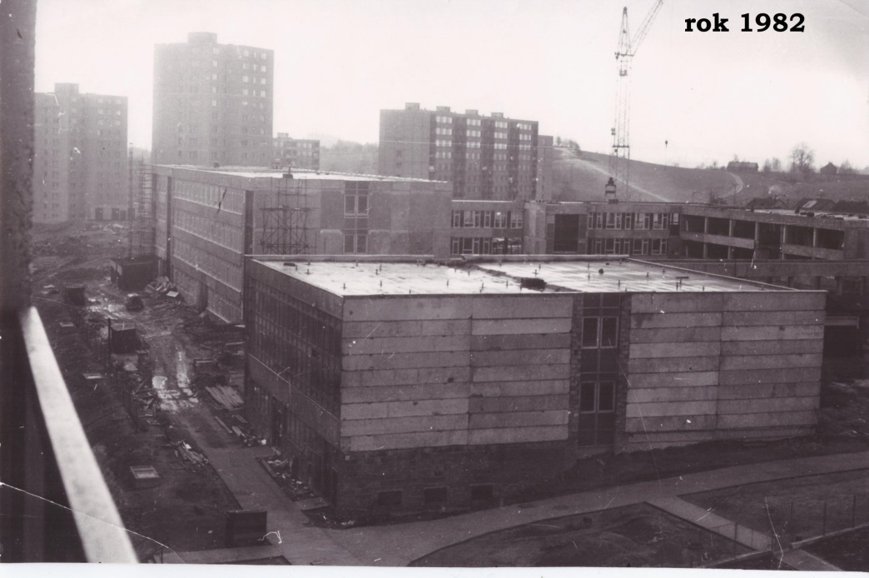
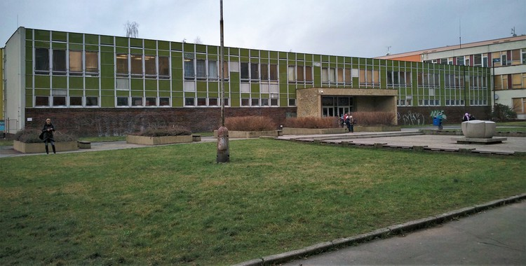
Before and after

Slide 4
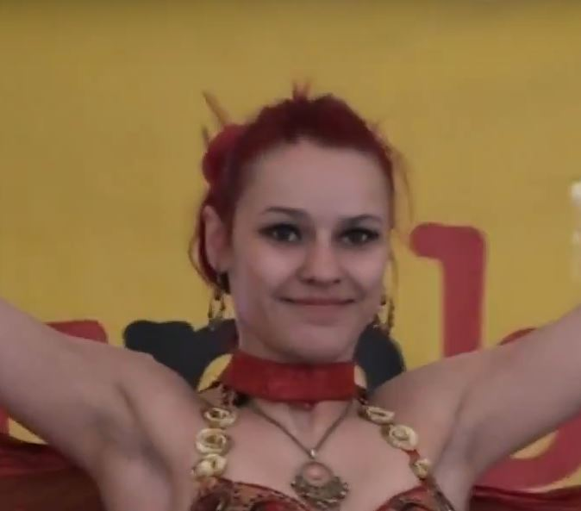
Our teacher
Mrs. Lupínková
She´s 26 years old
Her favourite colour is green and yellow
She´s got a brother and a sister
She´s married
She likes athletics
She likes Harry Potter
She teaches Czech,Maths,Geography,Music and Art

Slide 5
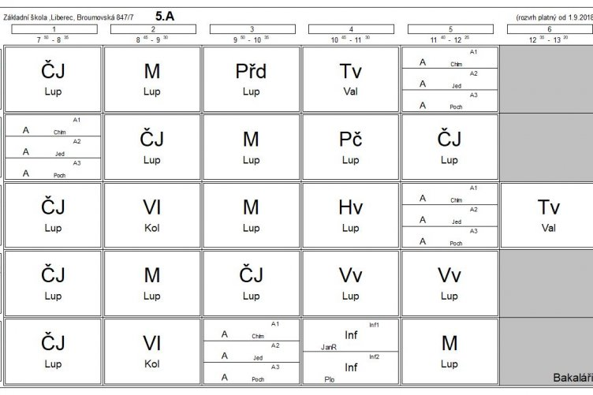
Our timetable

Slide 6
THANK YOU FOR YOUR ATTENTION

Slide 7
Sources
https://www.liberec.cz/cz/radnice/strategie-projekty/projekty-mesta/rekonstrukce-stavebni-upravy-broumovska/
https://www.zsbroumovska.cz/historie-skoly
https://www.zsbroumovska.cz/trida/5

