Slide 1
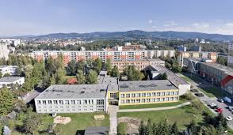
My School
My school is Brumovska
It´s great school with about five hundred pupils
And 35 teachers. The school is in Liberec.
We do not need to wear any uniforms,
pupils and the teachers walks in their clothes. In our school we are wery good
at Chess, we are in the twenty best schools in the Czech Republic.

Slide 2
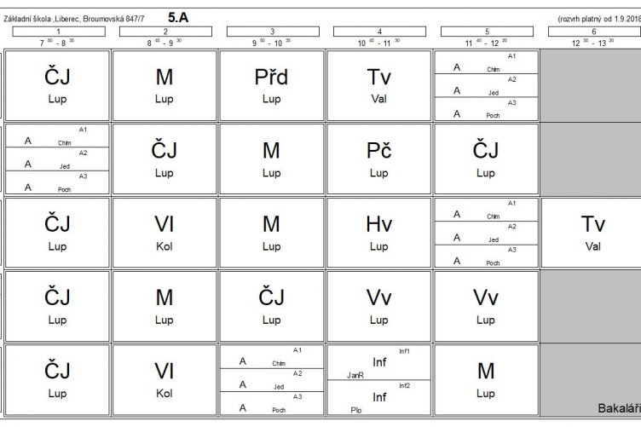
timetable

Slide 3
School sytem
primary
6-7 years 1 7-8 years 2
8-9 years 3
9-10 years 4
10-11 years 5
11-12 years 6
12-13 years 7
13-14 years 8
14-15 years 9
secondary

Slide 4
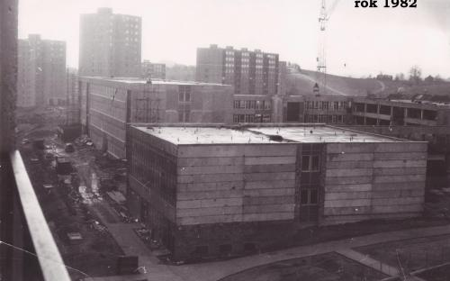
School History
The was first opened in 1.1. 1983
in Harusova street. There were
Twenty classes open and with 623 pupils
School in 1982 at construction site

Slide 5
MY class teacher is Tereza Lupinkova
She´s very good teacher. She´s 26 years old. Her
Favorite colour is green and yellow. Her favorite
animal is budgie. She´s got one brother and
one sister. Her favorite sport is atlethics.
At school she teaches Czech,Maths,Music and Art.
My English teacher is Zuzana Jedličková
She´s very good teacher. She´s the Czech republic in Liberec
Her favorite colour is blue. Her favorite food is stifado.
Her favorite sport is Biatlon.

Slide 6
Activies
MATHS. Two pupils likes Maths.
CZECH. One pupil like Czech.
PE. Five pupils likes PE.
ICT. Four pupils likes Ict.
ART. Three pupils Art.
HISTORY. One pupil like History.
ENGLISH. Two pupils likes English.
MUSIC and SIENCE. Nobody like it.

