Slide 1
Who am I?

Slide 2
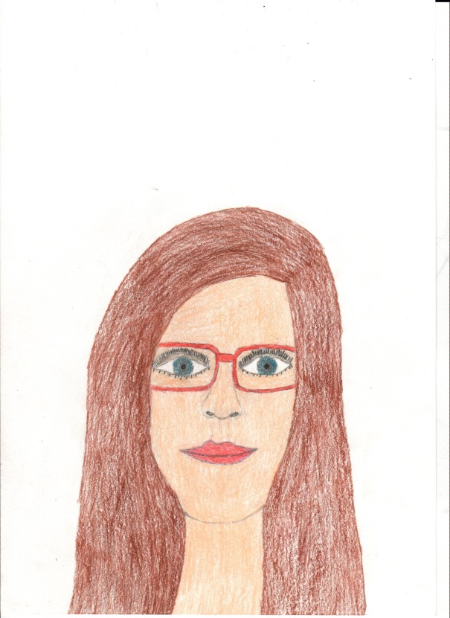
I am _______________
I‘ve got long hair and blue eyes. I wear glasses.
My favourite colours are blue and purple.

Slide 3
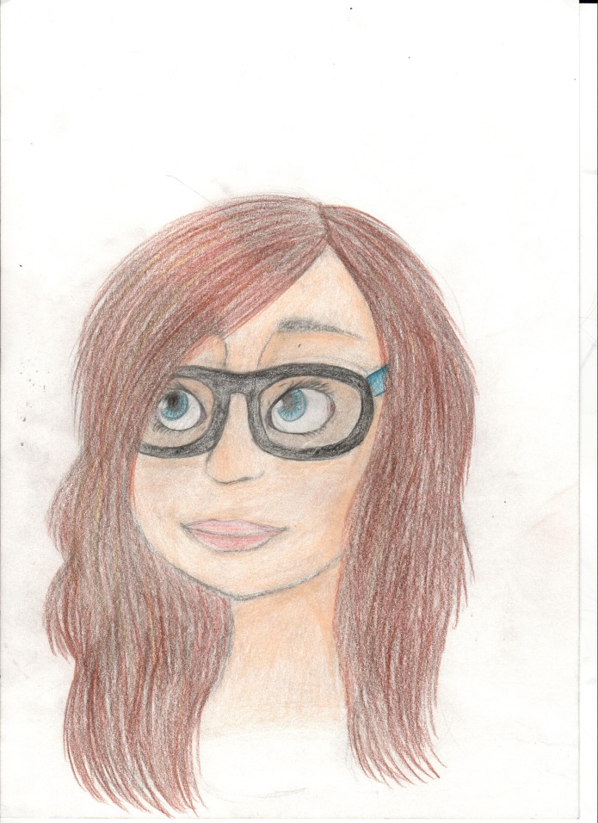
I am _________________
I‘ve got long brown hair
I‘ve got blue eyes
I wear glasses
I like Art and English
I don‘t like Maths
I like PC games
Pokémon is my favourite

Slide 4
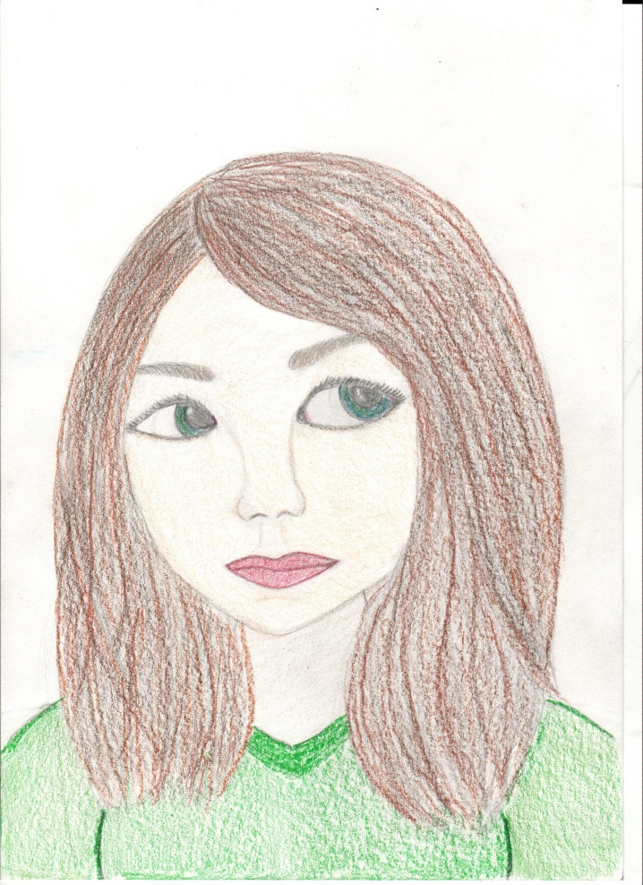
I am ______________
I‘ve got medium-lenght brown hair
I‘ve got green eyes
I like music, dancing, drawing
I like playing tennis

Slide 5
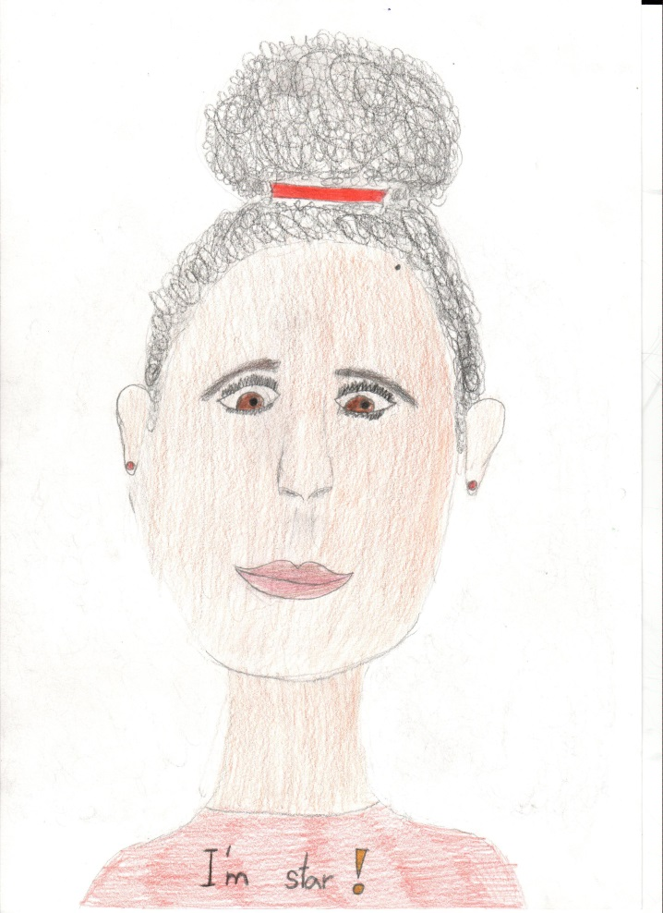
My name‘s______________
I‘ve got curly black hair
I‘ve got brown eyes
I‘ve got an older brother
I love hip-hop
I like playin tennis, but I‘m not good at it

Slide 6
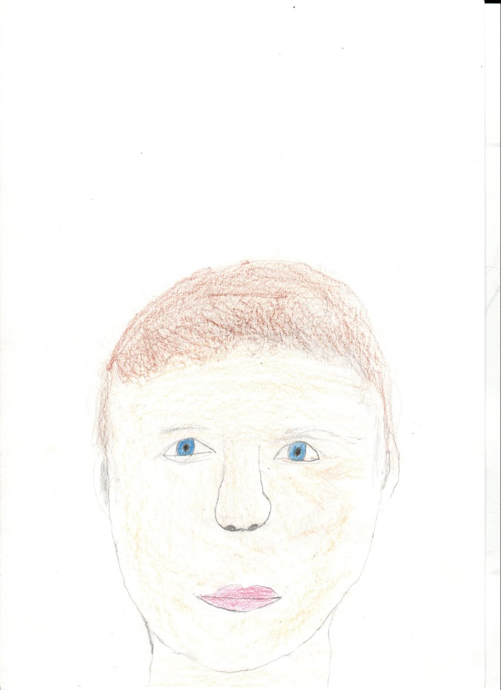
I am _____________
I‘m 11 years old
I‘ve got short red hair and blue eyes
I like playing PC games

Slide 7
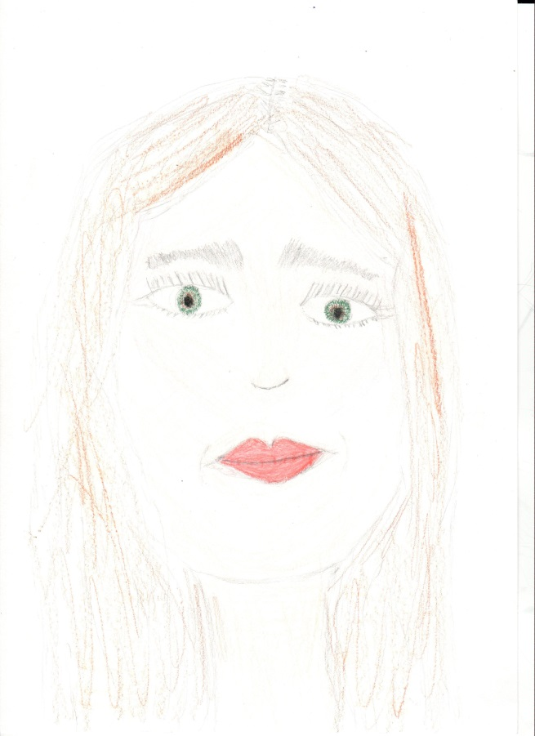
My name is___________
I‘ve got long fair hair
My eyes are green
I like hiking
I do athletics
I like emoji
My favourite colours are blue and black

Slide 8
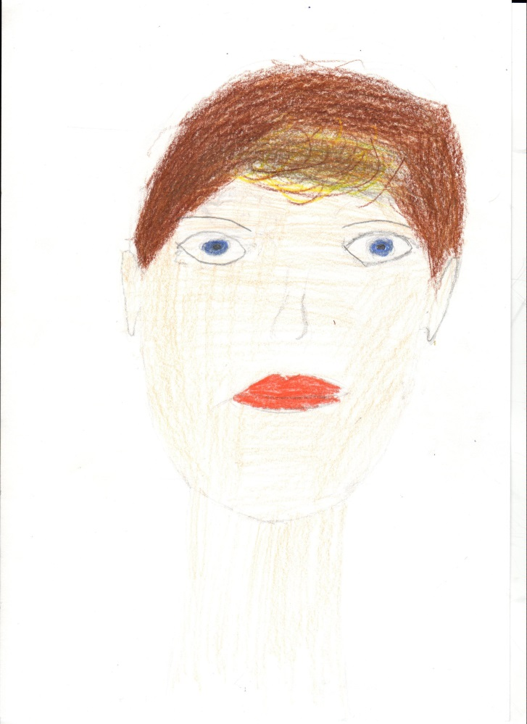
I‘m _________________
I‘ve got short brown hair and blue eyes
I‘ve got blue eyes
I like PC games

Slide 9
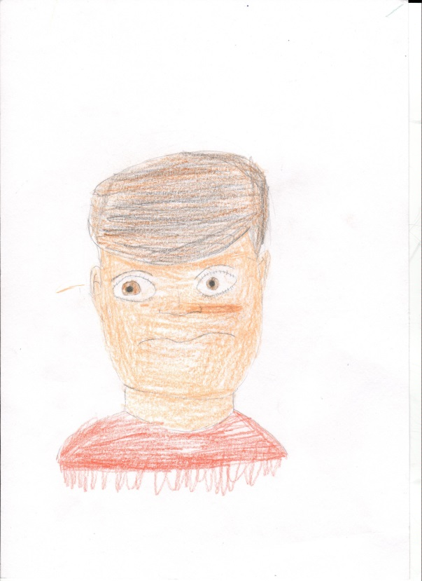
My name is ………….
I‘ve got brown eyes and brown hair
I like sports and console games
I like breaks at school
I like P.E. and Maths

Slide 10
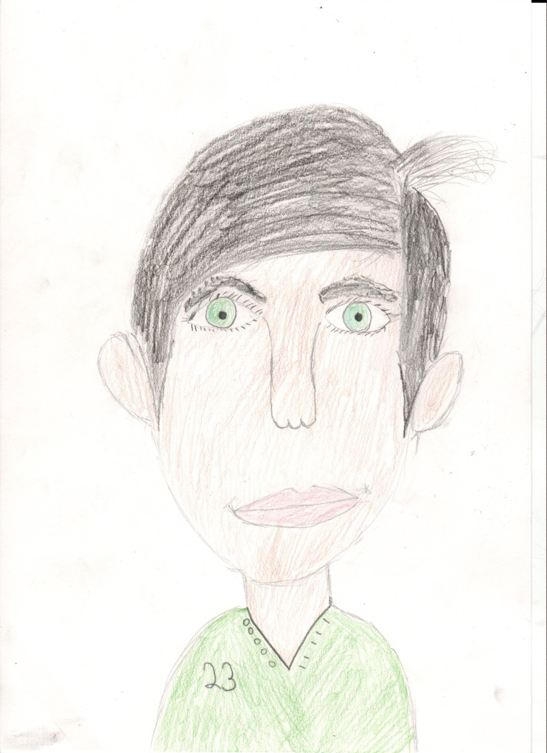
I am ……………..
I‘ve got green eyes and black hair
I like fingerboarding

Slide 11
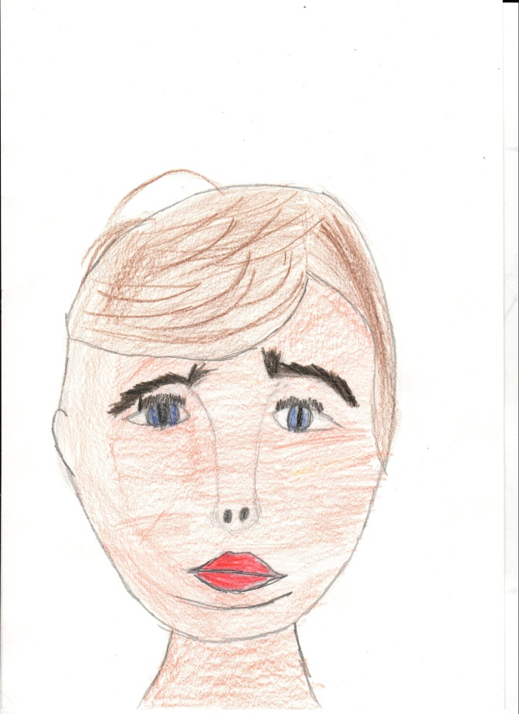
My name is………….
I‘ve got blue-green eyes
I‘ve got brown hair
I like playing PC games
I like P.E., Maths and English

Slide 12
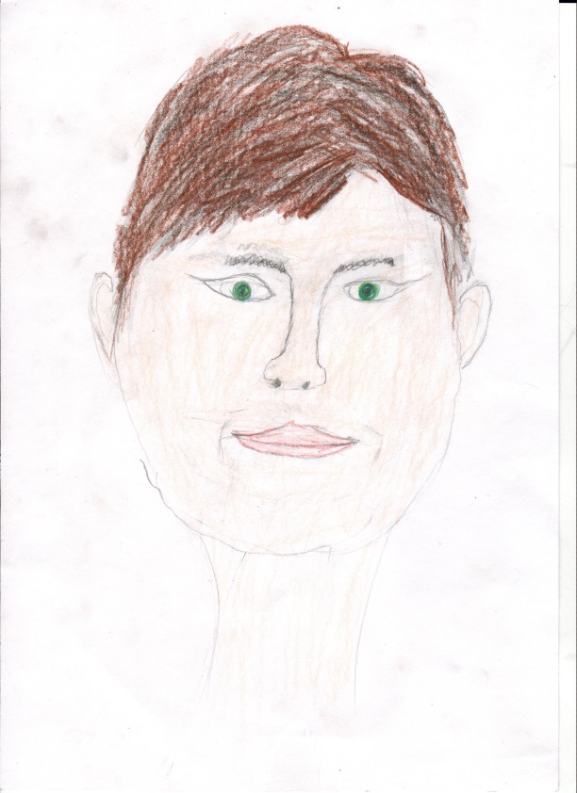
I am …………..
I am tall and slim
I‘ve got green eyes and brown hair
I like playing floorball

Slide 13
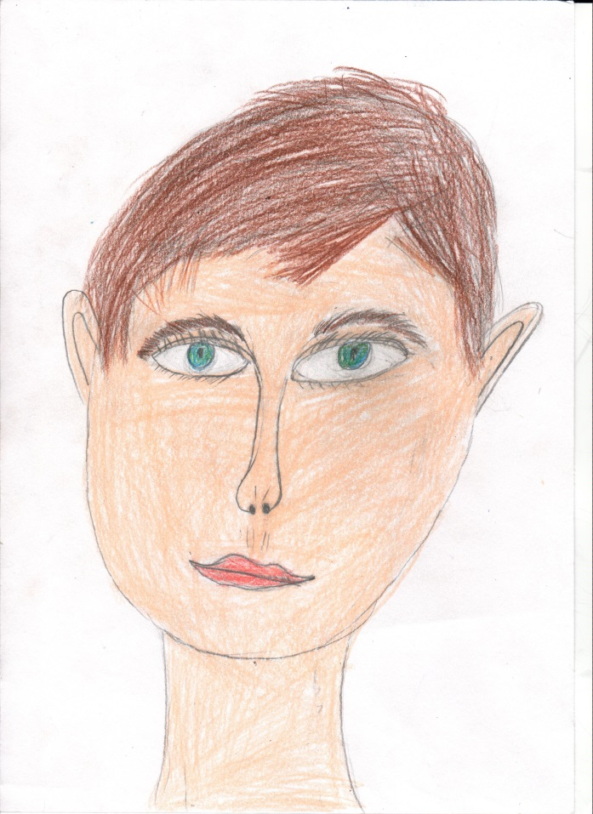
I am……………..
I‘m tall and slim
I‘ve got brown hair
I‘ve got blue eyes
I like historical fencing
I go swimming
I like making films

Slide 14
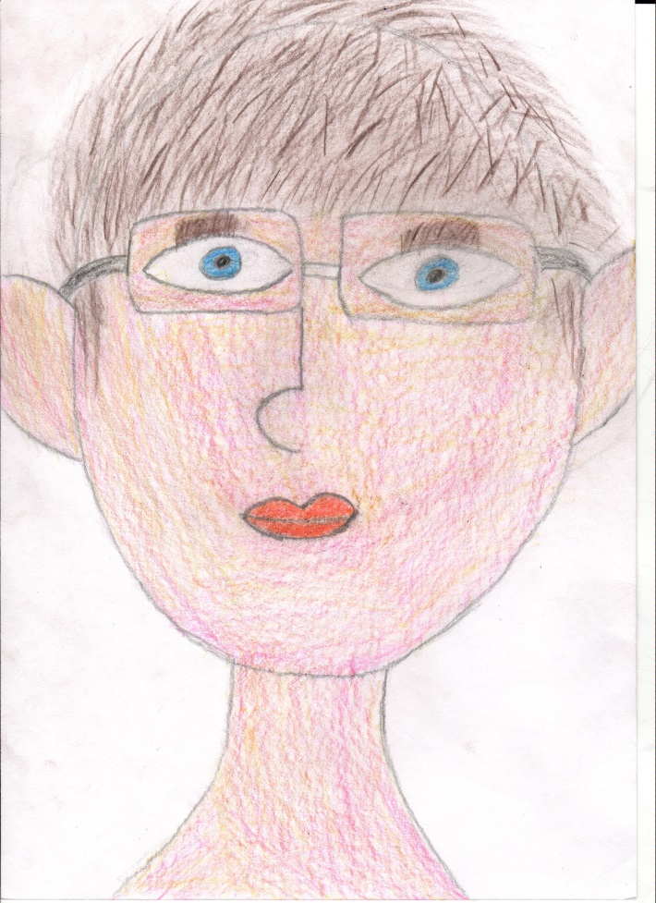
My name‘s………..
I‘ve got blue eyes
I‘ve got straight blond hair
I wear glasses
I like playing PC games
I like English and P.E.

Slide 15
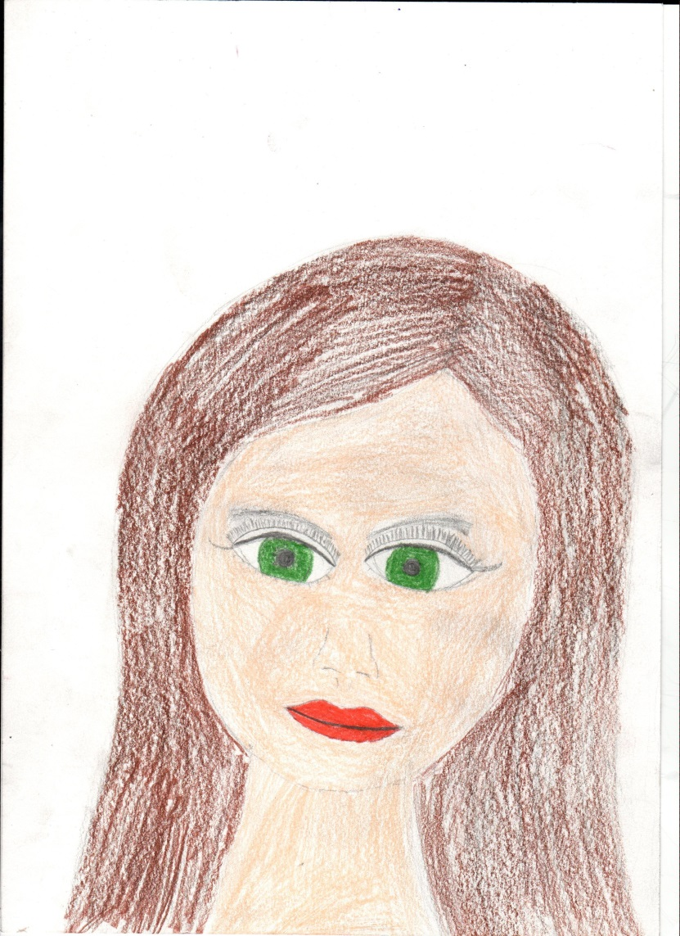
My name‘s………
I‘ve got green eyes
I‘ve got brown hair
I like floorball

Slide 16
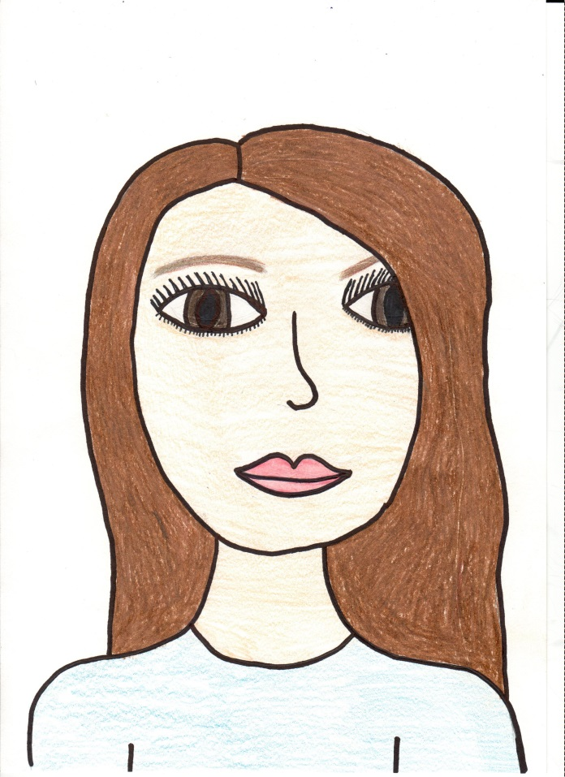
I am…………….
I‘ve got long brawn hair
I‘ve got brown eyes
I like swimming
I like cycling and painting
I like P.E., art and history
I like maths, too

Slide 17
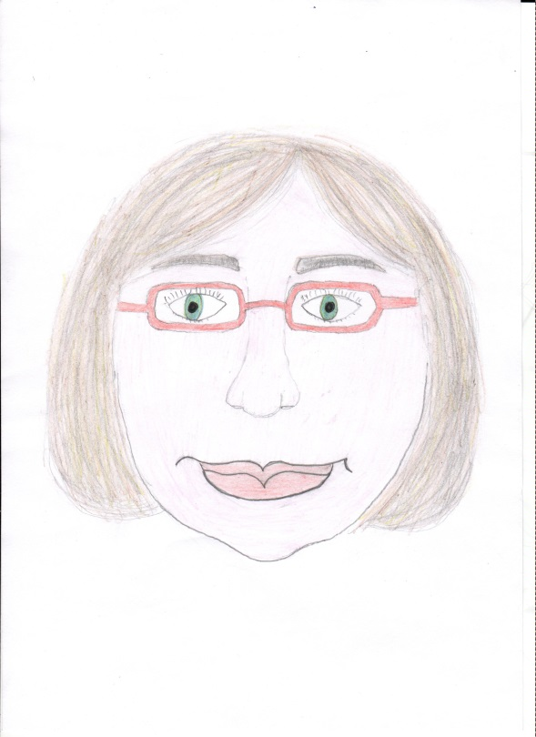
My name is ……………
I‘ve got fair hair and green eyes
I like athletics, especially running
I‘m tall
I wear glasses

